Slide 1
Introduction to Mobile-Cloud Computing

Slide 2
What is Mobile Cloud Computing?
Mobile cloud computing (MCC) at its simplest, refers to an infrastructure where both the data storage and data processing happen outside of the mobile device.
Mobile cloud applications move the computing power and data storage away from the mobile devices and into powerful and centralized computing platforms located in clouds, which are then accessed over the wireless connection based on a thin native client.

Slide 3
Why Mobile Cloud Computing?
Mobile devices face many resource challenges (battery life, storage, bandwidth etc.)
Cloud computing offers advantages to users by allowing them to use infrastructure, platforms and software by cloud providers at low cost and elastically in an on-demand fashion.
Mobile cloud computing provides mobile users with data storage and processing services in clouds, obviating the need to have a powerful device configuration (e.g. CPU speed, memory capacity etc), as all resource-intensive computing can be performed in the cloud.

Slide 4
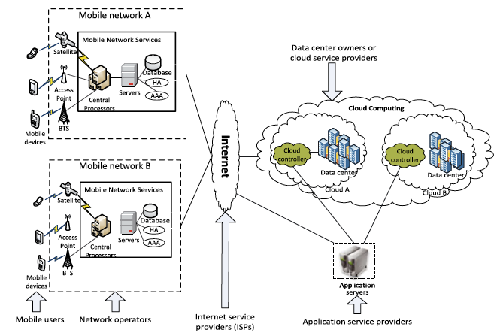
MCC Architecture

Slide 5
MCC Architecture
Mobile devices are connected to the mobile networks via base stations that establish and control the connections and functional interfaces between the networks and mobile devices.
Mobile users’ requests and information are transmitted to the central processors that are connected to servers providing mobile network services.
The subscribers’ requests are delivered to a cloud through the Internet.
In the cloud, cloud controllers process the requests to provide mobile users with the corresponding cloud services.

Slide 6
Advantages of MCC
Extending battery lifetime:
Computation offloading migrates large computations and complex processing from resource-limited devices (i.e., mobile devices) to resourceful machines (i.e., servers in clouds).
Remote application execution can save energy significantly.
Many mobile applications take advantages from task migration and remote processing.

Slide 7
Advantages of MCC
Improving data storage capacity and processing power:
MCC enables mobile users to store/access large data on the cloud.
MCC helps reduce the running cost for computation intensive applications.
Mobile applications are not constrained by storage capacity on the devices because their data now is stored on the cloud.

Slide 8
Advantages of MCC
Improving reliability and availability:
Keeping data and application in the clouds reduces the chance of lost on the mobile devices.
MCC can be designed as a comprehensive data security model for both service providers and users:
Protect copyrighted digital contents in clouds.
Provide security services such as virus scanning, malicious code detection, authentication for mobile users.
With data and services in the clouds, then are always(almost) available even when the users are moving.

Slide 9
Advantages of MCC
Dynamic provisioning:
Dynamic on-demand provisioning of resources on a fine-grained, self-service basis
No need for advanced reservation
Scalability:
Mobile applications can be performed and scaled to meet the unpredictable user demands
Service providers can easily add and expand a service

Slide 10
Advantages of MCC
Multi-tenancy:
Service providers can share the resources and costs to support a variety of applications and large no. of users.
Ease of Integration:
Multiple services from different providers can be integrated easily through the cloud and the Internet to meet the users’ demands.

Slide 11
MCC Applications
Mobile Commerce:
M-commerce allows business models for commerce using mobile devices.
Examples: Mobile financial, mobile advertising, mobile shopping…
M-commerce applications face various challenges (low bandwidth, high complexity of devices, security, …)
Integrated with cloud can help address these issues
Example: Combining 3G and cloud to increase data processing speed and security level.

Slide 12
MCC Applications
Mobile Learning:
M-learning combines e-learning and mobility
Traditional m-learning has limitations on high cost of devices/network, low transmission rate, limited educational resources
Cloud-based m-learning can solve these limitations
Enhanced communication quality between students and teachers
Help learners access remote learning resources
A natural environment for collaborative learning

Slide 13
MCC Applications
Mobile Healthcare:
M-healthcare is to minimize the limitations of traditional medical treatment (eg. Small storage, security/privacy, medical errors, …)
M-healthcare provides mobile users with convenient access to resources(eg. medical records)
M-healthcare offers hospitals and healthcare organizations a variety of on-demand services on clouds
Examples:
Comprehensive health monitoring services
Intelligent emergency management system
Health-aware mobile devices (detect pulse-rate, blood pressure, level of alcohol etc)
Pervasive access to healthcare information
Pervasive lifestyle incentive management (to manage healthcare expenses)

Slide 14
MCC Applications
Mobile Gaming:
M-game is a high potential market generating revenues for service providers.
Can completely offload game engine requiring large computing resource (e.g., graphic rendering) to the server in the cloud.
Offloading can also save energy and increase game playing time (eg. MAUI allows fine-grained energy-aware offloading of mobile codes to a cloud)
Rendering adaptation technique can dynamically adjust the game rendering parameters based on communication constraints and gamers’ demands

Slide 15
MCC Applications
Assistive technologies:
Pedestrian crossing guide for blind and visually-impaired
Mobile currency reader for blind and visually impaired
Lecture transcription for hearing impaired students
Other applications:
Sharing photos/videos
Keyword-based, voice-based, tag-based searching
Monitoring a house, smart home systems

Slide 16
MCC Issues
Mobile communication issues:
Low bandwidth: One of the biggest issues, because the radio resource for wireless networks is much more scarce than wired networks
Service availability: Mobile users may not be able to connect to the cloud to obtain a service due to traffic congestion, network failures, mobile signal strength problems
Heterogeneity: Handling wireless connectivity with highly heterogeneous networks to satisfy MCC requirements (always-on connectivity, on-demand scalability, energy efficiency) is a difficult problem

Slide 17
MCC Issues
Computing issues:
Computation offloading:
One of the main features of MCC
Offloading is not always effective in saving energy
It is critical to determine whether to offload and which portions of the service codes to offload
Two types:
Offloading in a static environment
Offloading in a dynamic environment

Slide 18
MCC Security Issues
Protecting user privacy and data/application secrecy from adversaries is key to establish and maintain consumers’ trust in the mobile platform, especially in MCC.
MCC security issues have two main categories:
Security for mobile users
Securing data on clouds

Slide 19
Security for Mobile Users
Issue
Mobile devices are exposed to numerous security threats like malicious codes and their vulnerability.
GPS can cause privacy issues for subscribers.
Solution: Security for mobile applications:
Installing and running security software are the simplest ways to detect security threats.

Slide 20
Securing data on clouds
Issue
Mobile devices are resource constrained, protecting them from the threats is more difficult than that for resourceful devices.
Solution
Integrity of data
Authentication
Digital right management

Slide 21
Location Based Awareness
Location-aware computing is a technology that uses the location of people and objects to derive contextual information with which to enhance the application behaviour.
There are two ways to acquire information about user context:
requiring the user to specify it
by monitoring users and computer activity
Sensor technology
Using GPS

Slide 22
Privacy Issues in MCC
Location based services (LBS) faces a privacy issue on mobile users’ provide private information such as their current location.
This problem becomes even worse if an adversary knows user’s important information.

Slide 23
Privacy Issues in MCC
Solution:
location trusted server (LTS) approach.
After receiving mobile users’ requests, LTS gathers their location information and cloaks the information called “cloaked region” to conceal user’s information.
The “cloaked region” is sent to LBS, so LBS knows only general information about the users but cannot identify them.

Slide 24
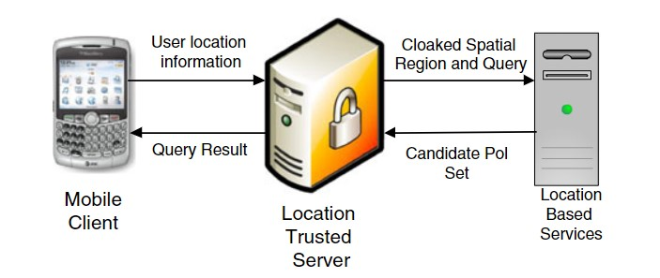

Slide 25
Context-aware Mobile Cloud Services
It is important to fulfill mobile users’ satisfaction by monitoring their preferences and providing appropriate services to each of the users.
Context-aware mobile cloud services try to utilize the local contexts (e.g., data types, network status, device environments, and user preferences) to improve the quality of service (QoS).

Slide 26
Open Issues in MCC
Network Access Management:
An efficient network access management not only improves link performance but also optimizes bandwidth usage.
Solution:
Cognitive radio can be expected as a solution to achieve the wireless access management.

Slide 27
Open Issues in MCC
Quality of Service:
How to ensure QoS is still a big issue, especially on network delay.
Solution
CloneCloud and Cloudlets are expected to reduce the network delay.
CloneCloud uses nearby computers or data centers to increase the speed of smart phone applications.
The idea is to clone the entire set of data and applications from the smartphone onto the cloud and to selectively execute some operations on the clones, reintegrating the results back into the smartphone.

Slide 28
Open Issues in MCC
Pricing:
MCC involves with both mobile service provider (MSP) and cloud service provider (CSP) with different services management, customers management, methods of payment and prices.
This will lead to many issues.
Solution:
The business model including pricing and revenue sharing has to be carefully developed for MCC.

Slide 29
Open Issues in MCC
Standard Interface:
Interoperability becomes an important issue when mobile users need to interact with the cloud.
Web interfaces may not be the best option.
It is not specifically designed for mobile devices.
May have more overhead.
Compatibility among devices for web interface could be an issue.
Standard protocol, signaling, and interface for interacting between mobile users and cloud would be required. (HTML5 & CSS3)
Solution:

Slide 30
Open Issues in MCC
Service Convergence:
Services will be differentiated according to the types, cost, availability and quality.
A single cloud may not be enough to meet mobile user’s demands.
Solution:
New scheme is needed in which the mobile users can utilize multiple cloud in a unified fashion.
The scheme should be able to automatically discover and compose services for user.
Sky computing is a model where resources from multiple clouds providers are leveraged to create a large scale distributed infrastructure.
The mobile sky computing will enable providers to support a cross-cloud communication and enable users to implement mobile services and applications.
Service integration (i.e., convergence) would need to be explored.

